Slide 1
Dolphin Swimming Club
Pool Party
Sadia Bibi, Floreza Jensen, Sune Hansen, Nicholas Hansen

Slide 2
Table of Contents
Part 1: Design Decisions: Nicholas
Part 2: Use Case: Create Member: Flor
Part 3: Program Introduction: Sadia
Part 4: Closer look at Code: Sune

Slide 3
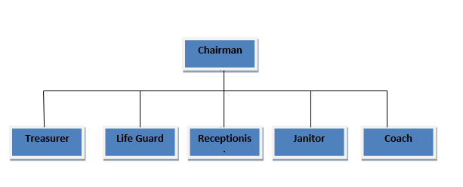
Part 1 : Design Decisions
Notes:
Very Flat
6 Positions all report to chairman

Slide 4
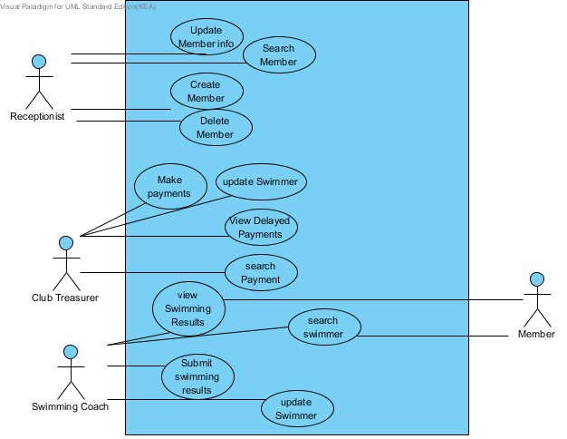
Use Case Diagram
Notes:
Are the F in furps+
As we have a fairly limited amount of Use cases we sought to look at each goal individually instead of Manage.
Identifying use cases was a matter of looking at requirements. As time went on we were able to identify many more.
Most important of them have been addressed in Fully dressed Use cases.
These are: Create Member, Search Member, Make Payment

Slide 5
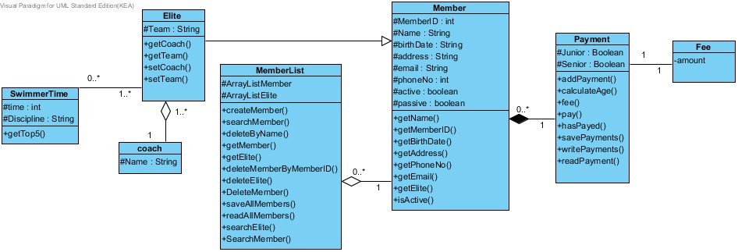

Slide 6
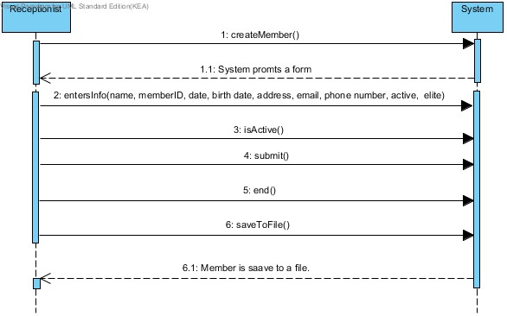
Part 2: Create Member SSD
Notes:
This diagram shows how the receptionist creates a member by entering the information we want to save, specifying whether or not the member is active and submitting the form. After that to successfully complete the process the receptionist must hit the save to file button and the information is saved to a file.

Slide 7
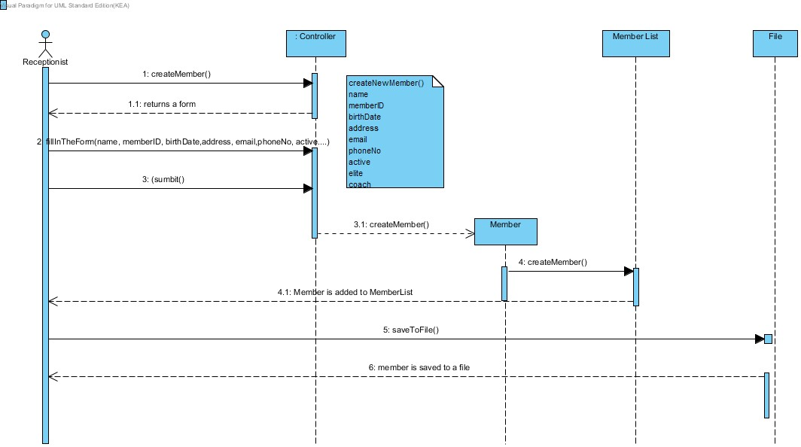
Create Member SD
Notes:
This diagram shows that when the Receptionist hits the submit button, a member object is created and added to the arraylists. When the receptionist hits the save to file button, the member object is saved to a file.

Slide 8
GRASP Responsibilities (Create member)
We assign the Controller object to deligates the tasks instead of going directly to its appropriate class.
Creator - Controller is the creator as it has initializing data to create a member instance.
Information expert - in this case, the Controller and MemberList are the Information expert as they have the information and functions to create a member object.
Low coupling And High Cohesion - It has low coupling as no classes relies so much on other classes and the cohesion is high as there are proper deligation of tasks between classes.
In this case, the Controller has the information to create a member object and the MemberList have the functions to add member in the ArrayList.

Slide 9
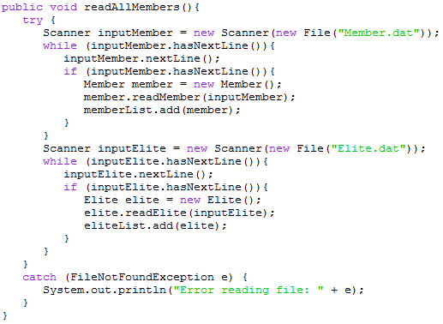
Part 4: Create Member code
1. Load members

Slide 10
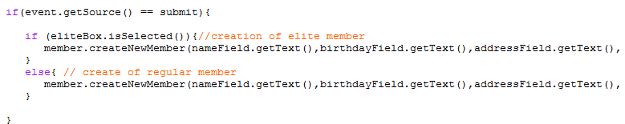
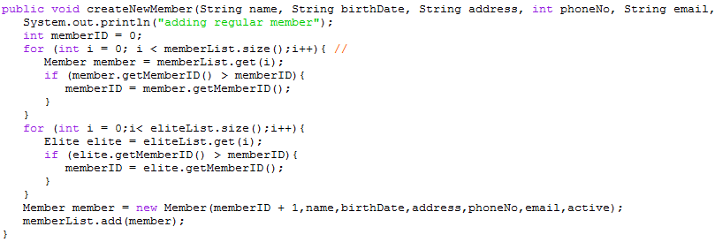
2. Fill out text fields
3. Get info from text fields
4. Create member

Slide 11
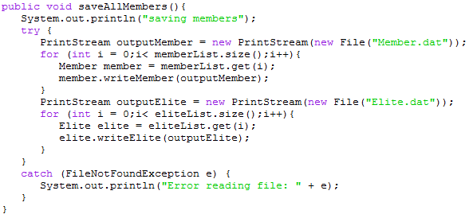
5. Save members

